Slide 1
Wine Reviews
By Wonhee Lee, Bu Nan

Slide 2
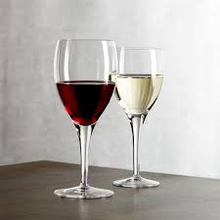
Statement of Purpose
Wine is commonly beloved around the world, yet most wine-lovers are not sommeliers.
Our database/application intends to help people find new wine products that will suit their taste.

Slide 3
Database Design
Wine
winery
country
variety
description
region_2
designation
region_1
points
province
price

Slide 4
Approach
Our approach is to construct an application based on the bag-of-words method that identifies the top 5 wine products matching the user’s preferences
Weight will be given in order of the keywords input
Moreover, database will be filtered by factor attributes for specific preferences with respect price, region, wine score that the user may have

Slide 5
Dataset
The Wine Reviews dataset on Kaggle
Consists of country, description, designation, points, price, province, region, variety, winery, title, taster_name and taster_twitter
Utilize all columns except taster info with primary focus on the description(‘reviews’) column

